Slide 1
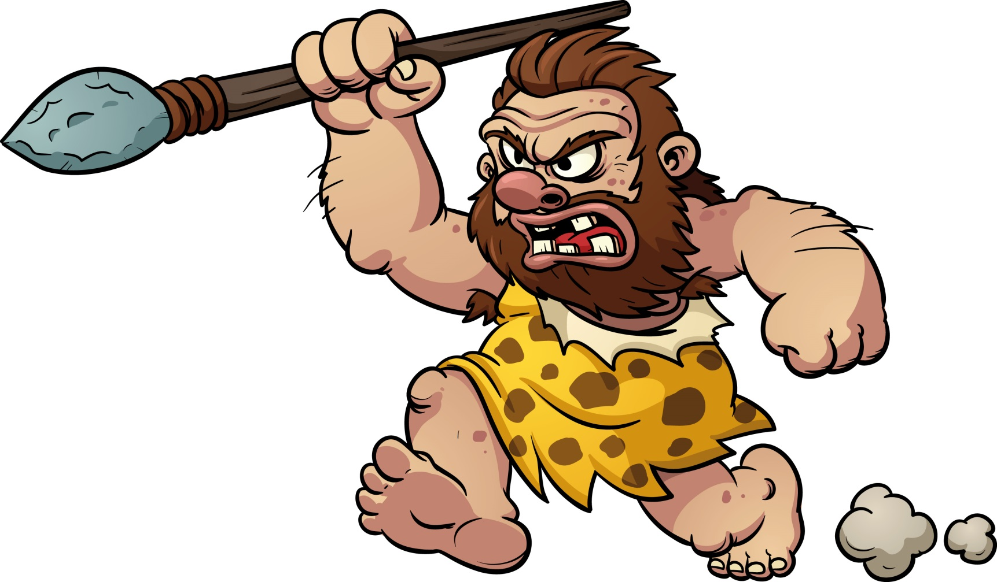
“Cave” men Turn and Talk
Aim: How does early man demonstrate progress toward a more organized and complex society?
List the words or ideas you associate with the term, “cave man.” Go to menti.com and use the code 9923 0594!

Slide 2
Late Paleolithic man End of the STONE AGE (~15,000 BCE– 8,000 B.C.E.)
Small societies of hunter-gatherers which have limited, yet present, political organization.
Females have an equal role in society. Egalitarian = equal! Very little class division.
Nomadic societies – constantly on the move. Humans used stone, bone and wood tools.
End of the last ice age around 12,000 BCE. A long period of global warming.
Initial Domestication of plants and animals occurs from 9500-7000 BCE.

Slide 3
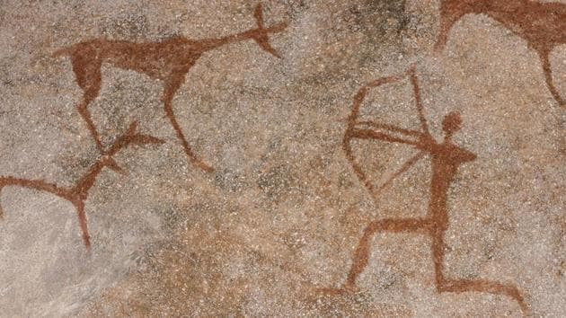
Pick one partner to work with If there is an odd number of students at your table, a group of 3 is acceptable. You will need to communicate with each other to complete this task!
Aim: How does early man demonstrate progress toward a more organized and complex society?
Have each group member pick a number either 1 or 2!

Slide 4
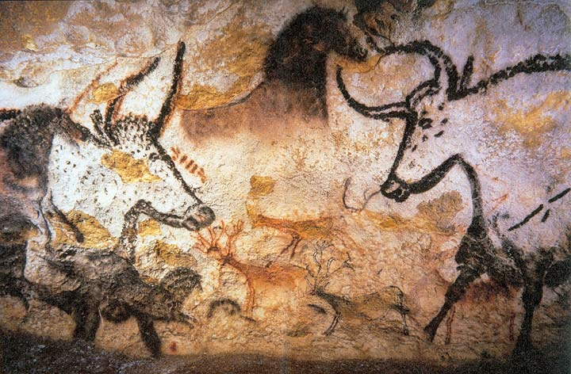
What is going on in this picture? You have 2 minutes to describe this to your partner! Go!

Slide 5
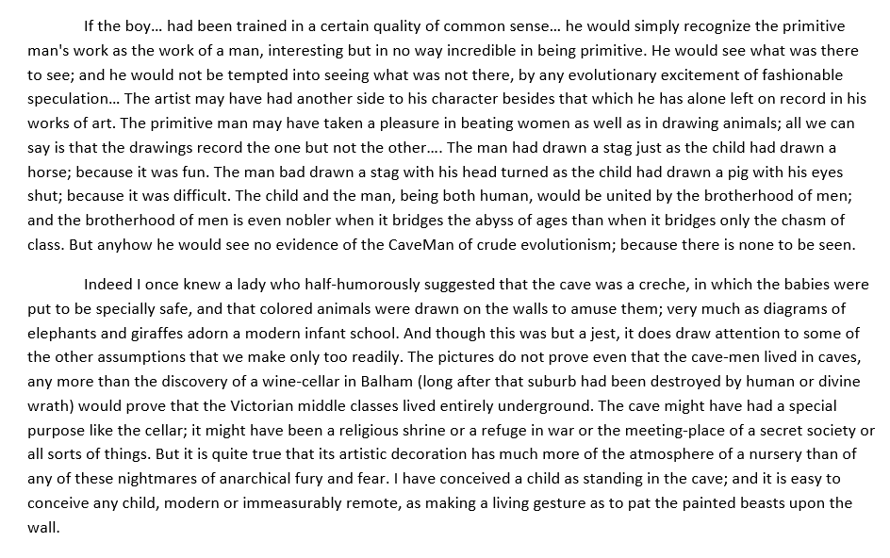
…
Aim: How does early man demonstrate progress toward a more organized and complex society?

Slide 6
The Man in the Cave
Aim: How does early man demonstrate progress toward a more organized and complex society?
Pick and answer two of the following questions in your notes.
1. What is the author’s main argument about Paleolithic man? What points does he make to suggest this?
2. Which details from the text connect Paleolithic man to people today?
3. How does Chesterton challenge assumptions of social scientists before him? What lesson can be learned about the study of history?

Slide 7
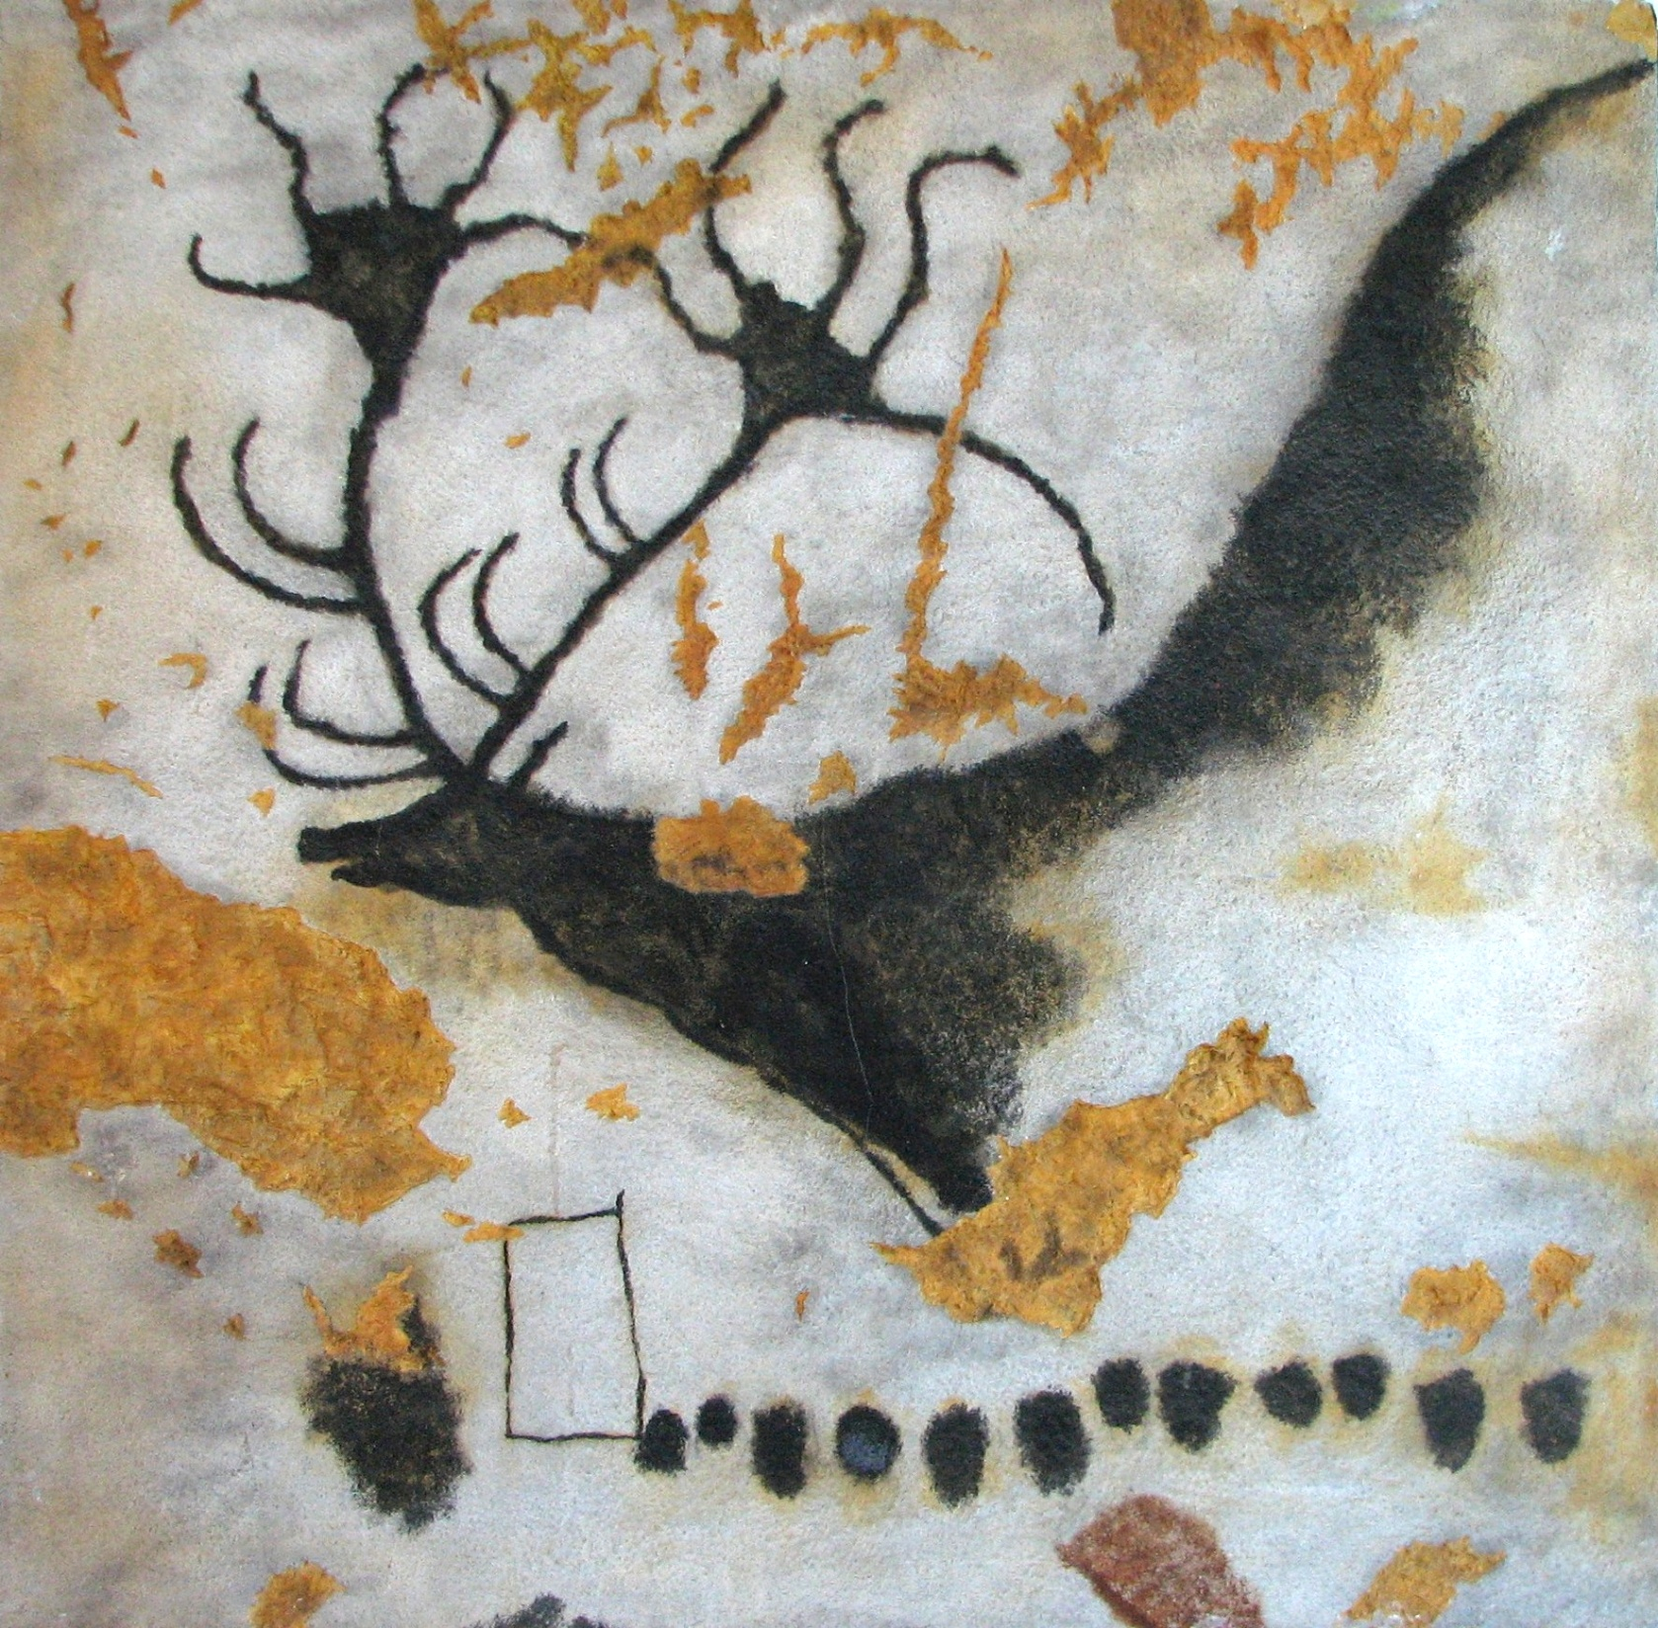

Slide 8
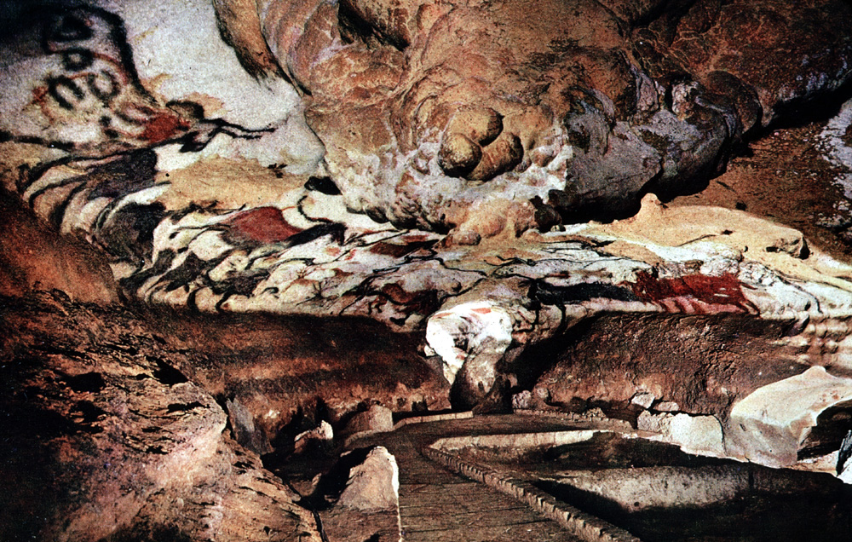

Slide 9
Summary
Aim: How does early man demonstrate progress toward a more organized and complex society?
To what extent can the Paleolithic man be considered complex?

